Slide 1
UML

Slide 2
What is a Use Case Diagram?
A Use Case Diagram is a type of diagram used in Software Engineering to show how a system interacts with users (called actors). It focuses on what the system does, not how it does it.

Slide 3
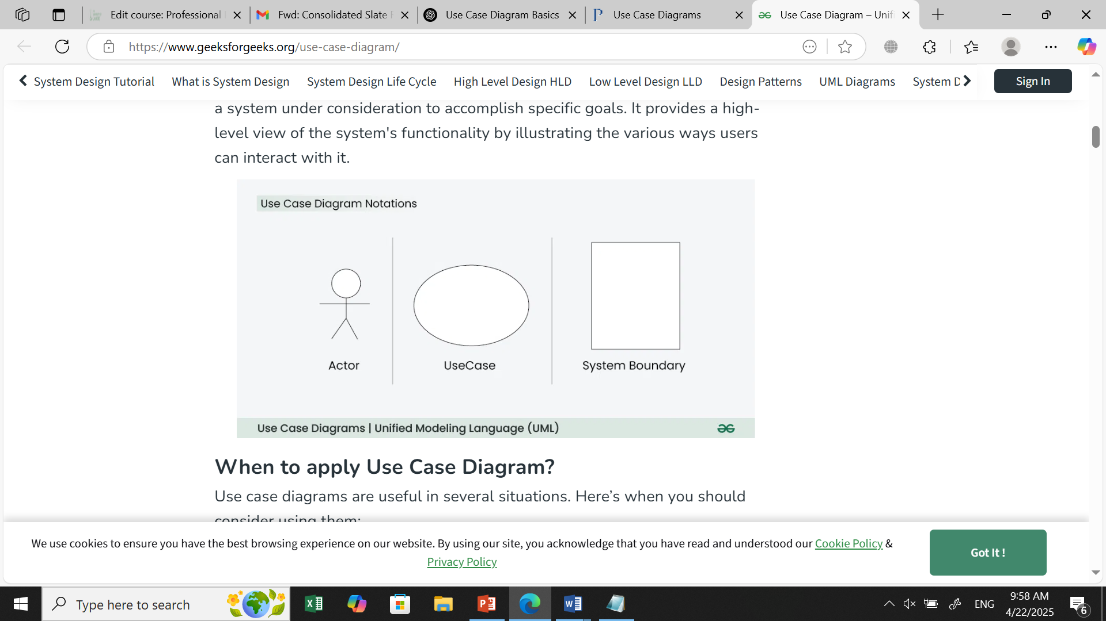
Main Elements of a Use Case Diagram
Element | Description
Actor | A person or system that interacts with your software. Example: "User", "Admin".
Use Case | A task or function the system performs. Example: "Login", "Register", "Upload File".
System Boundary | A box that shows the scope of the system. All use cases are inside it.
Relationships | Connect actors to use cases. Different types show different interactions.

Slide 4
Example
Imagine you're using a mobile app. Everything you do with the app (like login, send message, or check your balance)—those are use cases.
You (the person using the app) are an actor.

Slide 5
ATM Machine
Actors:
Customer
Bank Server (system)
Use Cases:
Insert Card
Enter PIN
Withdraw Cash
Check Balance
Simple Use Case Description:
Actor | Use Case | Description
Customer | Insert Card | User inserts ATM card to access services
Customer | Enter PIN | Enters their secret PIN to verify identity
Customer | Withdraw Cash | Takes out money from their account
Customer | Check Balance | Views account balance

Slide 6
Types of Relationships
Association ( )
Shows which actor uses which use case.
Example: User — Login
Include (<<include>>)
Reuse of a common use case.
Example: Register <<include>> Verify Email
Extend (<<extend>>)
Optional behavior that happens under certain conditions.
Example: Checkout <<extend>> Apply Discount
Generalization ( )
Used when one actor or use case is a special type of another.
Example: Admin is a type of User.

Slide 7
Use Case Diagram Relationships
In a Use Case Diagram, relationships play a crucial role in depicting the interactions between actors and use cases. These relationships provide a comprehensive view of the system's functionality and its various scenarios. Let's delve into the key types of relationships and explore examples to illustrate their usage.

Slide 8
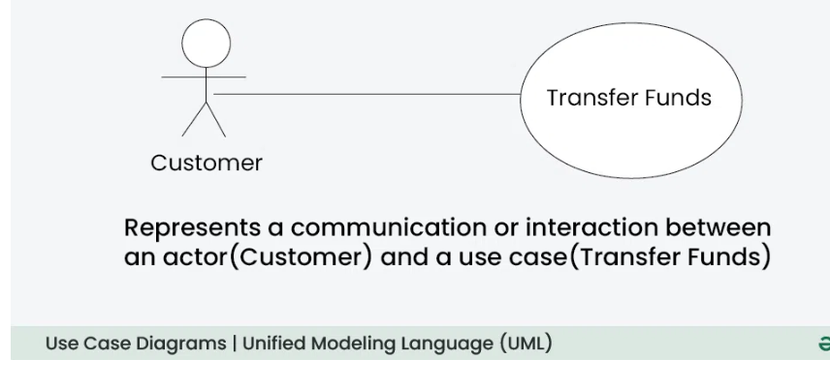
Association Relationship
The Association Relationship represents a communication or interaction between an actor and a use case. It is depicted by a line connecting the actor to the use case. This relationship signifies that the actor is involved in the functionality described by the use case.
Example: Online Banking System
Actor: Customer
Use Case: Transfer Funds
Association: A line connecting the "Customer" actor to the "Transfer Funds" use case, indicating the customer's involvement in the funds transfer process.

Slide 9
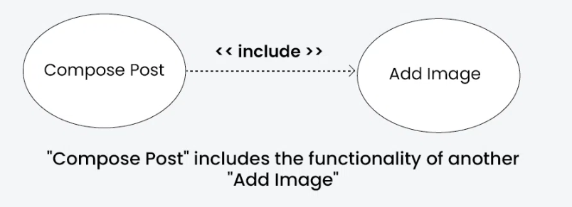
Include Relationship
The Include Relationship indicates that a use case includes the functionality of another use case. It is denoted by a dashed arrow pointing from the including use case to the included use case. This relationship promotes modular and reusable design.
Example: Social Media Posting
Use Cases: Compose Post, Add Image
Include Relationship: The "Compose Post" use case includes the functionality of "Add Image." Therefore, composing a post includes the action of adding an image.

Slide 10
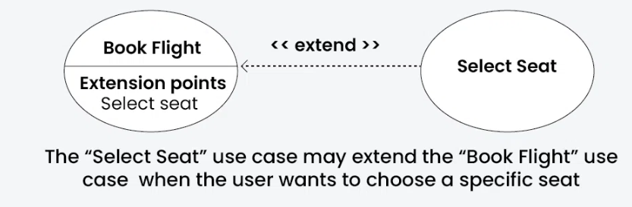
Extend Relationship
The Extend Relationship illustrates that a use case can be extended by another use case under specific conditions. It is represented by a dashed arrow with the keyword "extend." This relationship is useful for handling optional or exceptional behavior.
Example: Flight Booking System
Use Cases: Book Flight, Select Seat
Extend Relationship: The "Select Seat" use case may extend the "Book Flight" use case when the user wants to choose a specific seat, but it is an optional step.

Slide 11
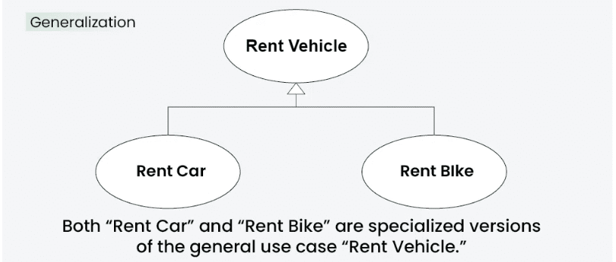
Generalization Relationship
The Generalization Relationship establishes an "is-a" connection between two use cases, indicating that one use case is a specialized version of another. It is represented by an arrow pointing from the specialized use case to the general use case.
Example: Vehicle Rental System
Use Cases: Rent Car, Rent Bike
Generalization Relationship: Both "Rent Car" and "Rent Bike" are specialized versions of the general use case "Rent Vehicle."

Slide 12
How to draw a Use Case diagram in UML?
Step 1: Identify Actors: Determine who or what interacts with the system. These are your actors. They can be users, other systems, or external entities.
Step 2: Identify Use Cases: Identify the main functionalities or actions the system must perform. These are your use cases. Each use case should represent a specific piece of functionality.
Step 3: Connect Actors and Use Cases: Draw lines (associations) between actors and the use cases they are involved in. This represents the interactions between actors and the system.
Step 4: Add System Boundary: Draw a box around the actors and use cases to represent the system boundary. This defines the scope of your system.
Step 5: Define Relationships: If certain use cases are related or if one use case is an extension of another, you can indicate these relationships with appropriate notations.
Step 6: Review and Refine: Step back and review your diagram. Ensure that it accurately represents the interactions and relationships in your system. Refine as needed.
Step 7: Validate: Share your use case diagram with stakeholders and gather feedback. Ensure that it aligns with their understanding of the system's functionality.

Slide 13
Use Case Diagram example(Online Shopping System)
Let's understand how to draw a Use Case diagram with the help of an Online Shopping System:
Actors:
Customer
Admin
Use Cases:
Browse Products
Add to Cart
Checkout
Manage Inventory (Admin)
Relations:
The Customer can browse products, add to the cart, and complete the checkout.
The Admin can manage the inventory.

Slide 14
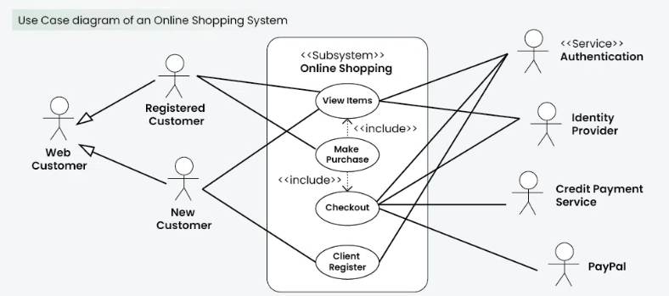

Slide 15
Common Mistakes while making Use Case Diagram?
Avoiding common mistakes ensures the accuracy and effectiveness of the Use Case Diagram. Here are key points for each mistake:
Adding too much detail can confuse people.
Unclear connections lead to misunderstandings about system interactions.
Different names for the same elements create confusion.
Incorrectly using generalization can misrepresent relationships.
Failing to define the system’s limits makes its scope unclear.
Treating the diagram as static can make it outdated and inaccurate.

Slide 16
Purpose and Benefits of Use Case Diagrams?
The Use Case Diagram offers numerous benefits throughout the system development process. Here are some key advantages of using Use Case Diagrams:
Use Case Diagrams offer a clear visual representation of a system’s functions and its interactions with external users. This representation helps stakeholders, including those without technical expertise, in grasping the system’s overall behavior.
They establish a shared language for articulating system requirements, ensuring that all team members have a common understanding.
Use Case Diagram illustrate the different ways users engage with the system, contributing to a thorough comprehension of its functionalities.
In the design phase, Use Case Diagrams help outline how users (actors) will interact with the system. They support the planning of user interfaces and aid in structuring system functionalities.

Slide 17
Common Use Case Diagram Tools
Lucidchart:
draw.io:
Microsoft Visio:
SmartDraw:
PlantUML:

Slide 18
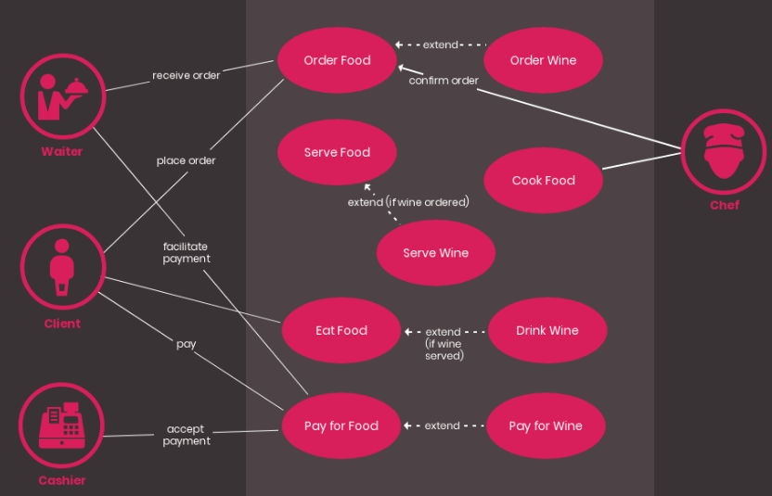
Restaurant use case diagram

Slide 19
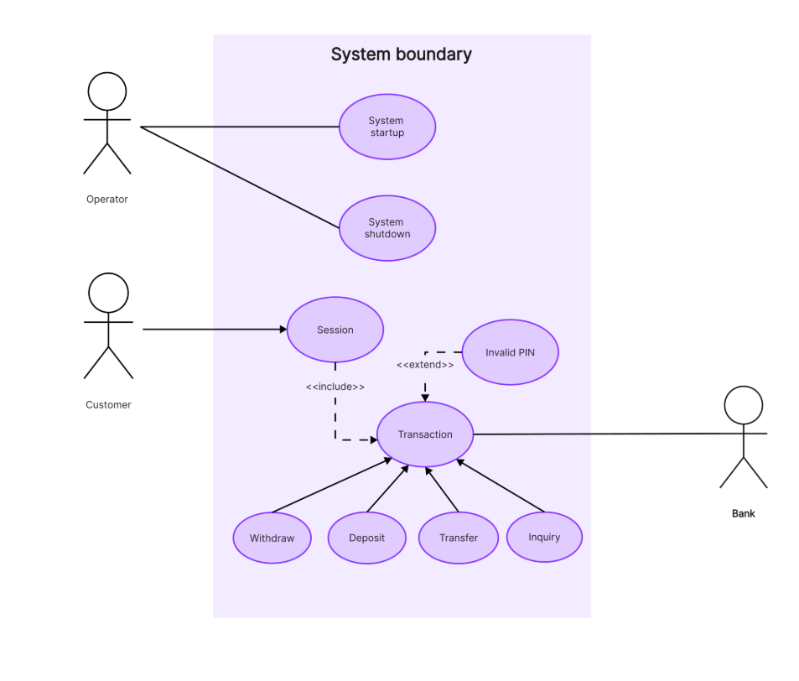

Slide 20
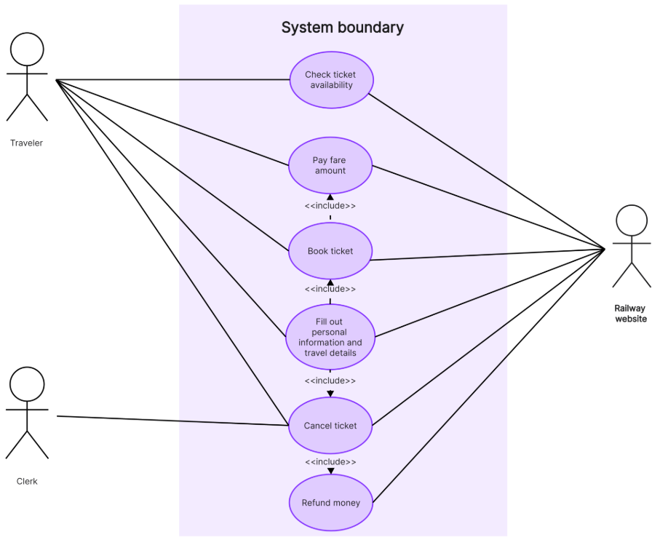
Railway Reservation System

Slide 21
Travel use case diagram
Banking use case diagram
Hospital Management system use case diagram
Student Management System use case diagram

